Slide 1

Recognition Framework
Sonja Filiposka
on behalf of
Katrine Weisteen Bjerde, HK-DIR

Slide 2
Purpose of the Recognition Framework?
Define the use of digital credentials
To give Open Science professionals/experts proof of their instructor/trainer skills
For employers to be able to recognize these skills across Europe

Slide 3









The process
---------------------
---------------------
FAIR-by-design methodology for learning material
Quality assurance for learning material
---------------------
---------------------
MVS define skills for Open Science profiles
The methodology defines the workflow for creating FAIR learning materials
QA Checklists to assess quality of learning materials
Learning material is developed
Credentials are issued after completing course + assessment

Slide 4




Recognition Framework Requirements
Flexible
Inexpensive
Easy to implement
Trustworthy
institutions use parts that suit their needs and adapt them to their context
no high additional costs
technical parts of the framework are based on open standards and easy to implement
individual can safely store the credential and easily share it with third parties to validate

Slide 5
Digital Credentials for Attendance Only
PROs
CONs
Encourages Participation
Can motivate more individuals to participate, as they receive recognition simply for being present.
Inclusivity
It allows all participants, regardless of their performance in assessments, to receive a credential, promoting inclusivity and reducing the pressure of assessment.
Easy to Administer
Straightforward to issue, reducing administrative overhead.
Building a Learning Culture
Can contribute to a culture of continuous learning, encouraging individuals to engage in more training opportunities.
Limited Value
Attendance may carry less weight since they do not necessarily indicate that the recipient has gained or demonstrated any specific skills or knowledge.
Potentially Misleading
Could be misleading if interpreted as a sign of competency when they only signify participation.
Lack of Differentiation
No distinction between those who merely attend and those who actively engage and master the material, potentially diminishing the credential’s perceived value.

Slide 6
Digital Credentials for Successful Completion of Assessment
PROs
CONs
Demonstrates Competency
Recipient has not only attended the training but also successfully demonstrated understanding and application of the material, making them more meaningful and valuable.
Higher Recognition
Often more respected by employers and peers, as they provide evidence of skills and knowledge.
Motivates Learning
Knowing that they must pass an assessment to receive a credential can motivate participants to engage more.
Differentiates Skill Levels
Differentiates between who mastered the material and who has not, which can be important in professional or academic settings.
Excludes Some Participants
Those who struggle with assessments may not receive a credential, which could discourage participation and be seen as less inclusive.
Increased Pressure
Participants may feel more stressed or anxious about assessments, which could negatively impact their learning experience.
More Complex Administration
Administering assessments and issuing credentials based on performance requires more resources, including time, effort, and sometimes technology, to ensure fair and accurate evaluation.
Risk of Credential Inflation
If not carefully designed, assessments could lead to credential inflation, where the credential becomes less valuable due to inconsistent or low standards.

Slide 7
Looking for a ….
standard
verifiable
portable
shareable
digital
micro-credentials
rich metadata

Slide 8
Results of the landscaping
OBERRED Open Badges
NI4OS-Europe Open Badges
The Carpentries Proprietary
RItrainPlus – Not decided
EC European Digital Credentials
NASA TOPS Open Badges
Linux Professional Institute Proprietary
Open Data Institute Proprietary
DC4EU agnostic
EOSC Future Open Badges
Digital Credentials Consortium Open Badges
DocTalent4EU European Digital Credentials

Slide 9
Viable Options
Open Badges
EU Digital Credentials

Slide 10
What are Open Digital Badges?
created and issued to recognise
competencies
skills
achievements or
attitudes
a digital picture with metadata
informs who has issued the badge to whom and on what basis
standard and verifiable portable digital credential
metadata aligns with the Open Badges standard created by the Mozilla Foundation and further developed by IMS global

Slide 11
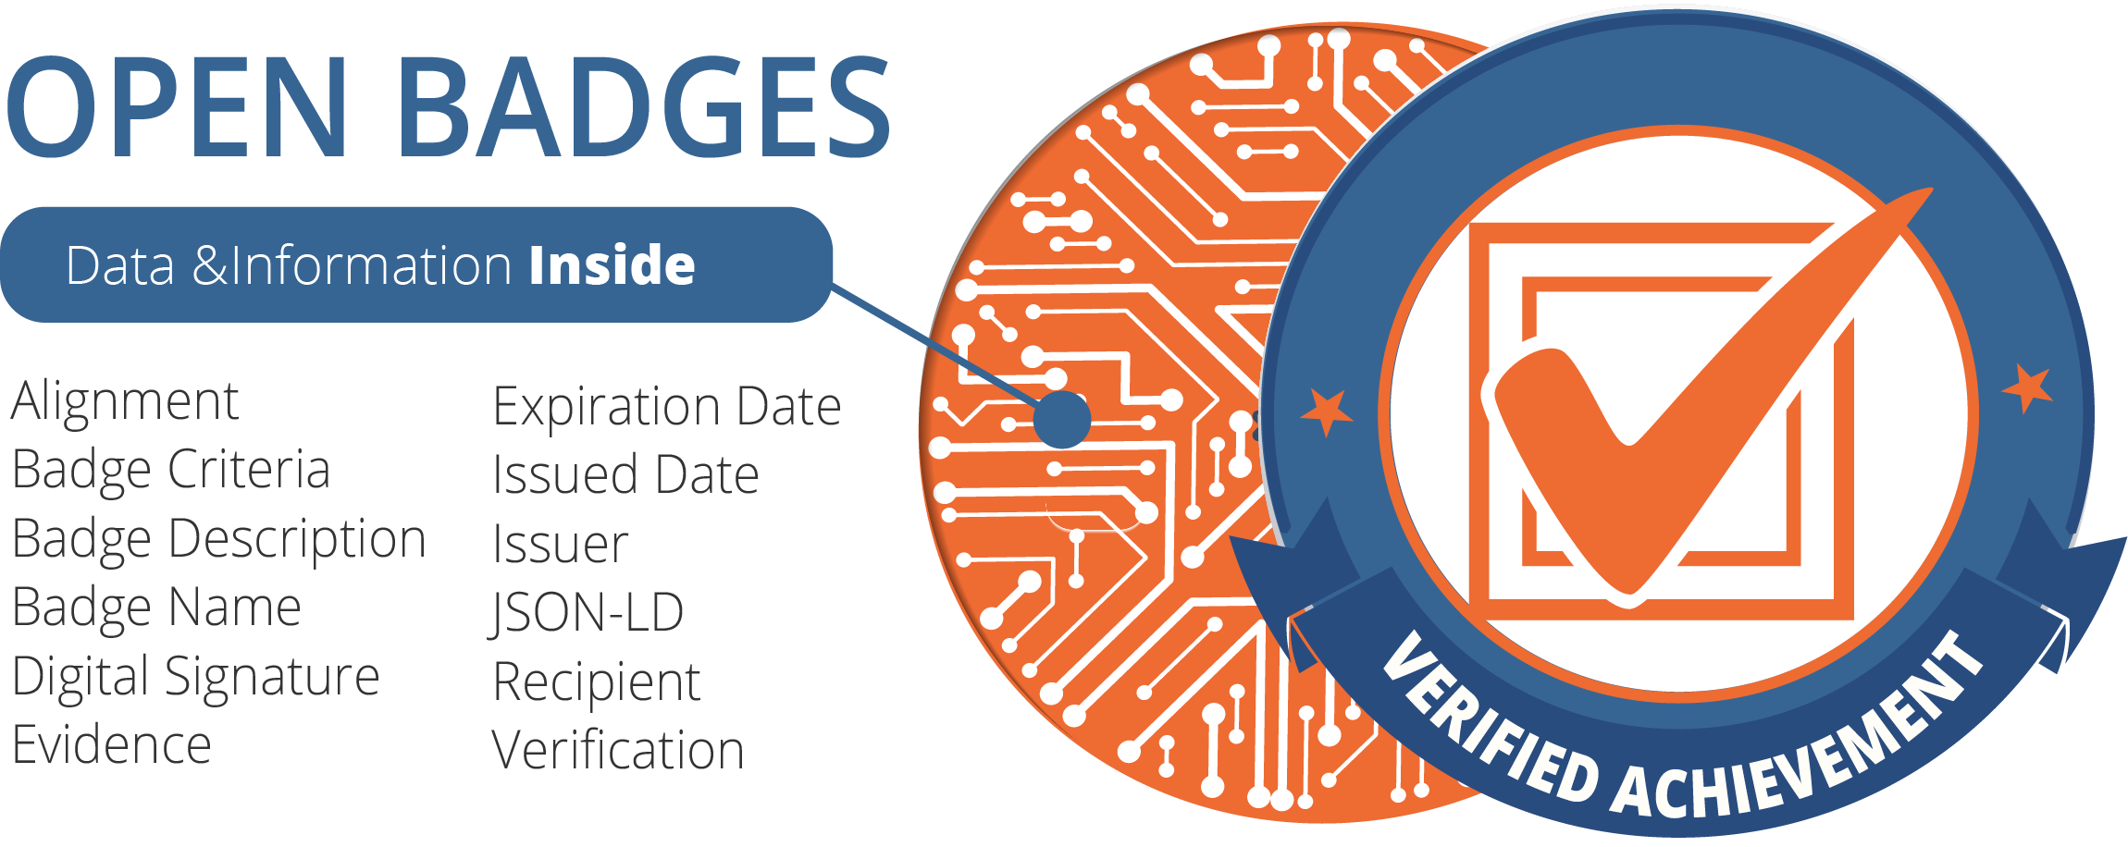
Open Badges Content
Image plus
name of the badge
description
creator write descriptions of the badge
criteria info
badge issuer presents the criteria used to recognise the skills, achievements or competences of the recipient
Open Badge content by 1EdTech, licensed under CC-BY-4.0

Slide 12

Gathering & Sharing Open Badges
Badges can be collected
in a backpack, passport, or wallet solution
https://badgr.com/
Collections can be created to group individual badges into categories
Badges can be shared on social media
People can click on an Open Badge, view all the evidence, read details about the achievement, and verify the badge's authenticity

Slide 13
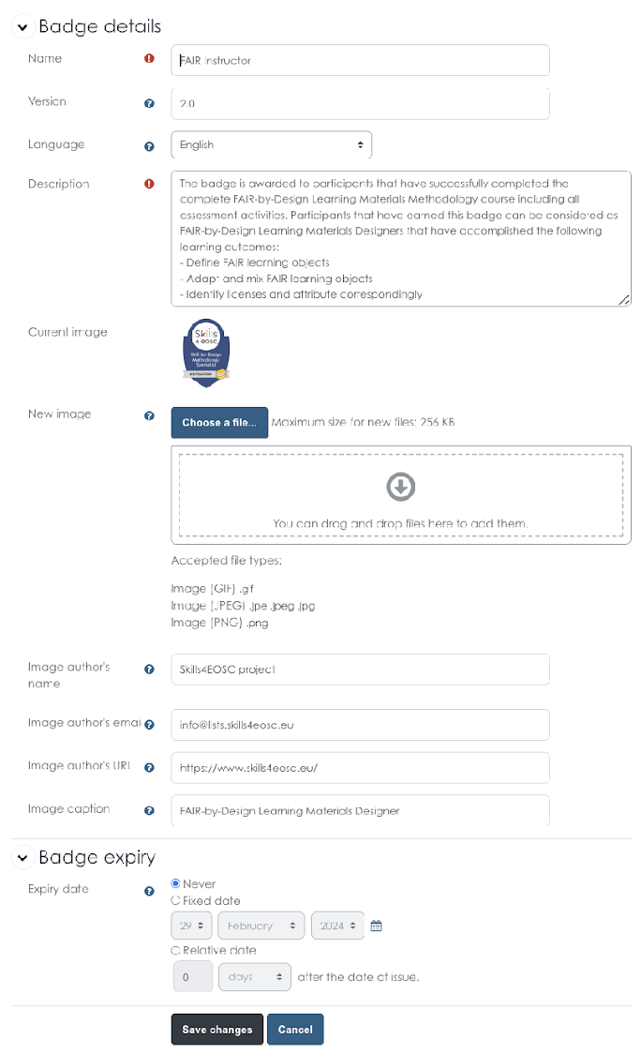
Issuing Open Badges
Can be integrated with a Learning Platform
Prepare the image using templates
Fill out the badge details
Issuing criteria
Manual
Automatic

Slide 14
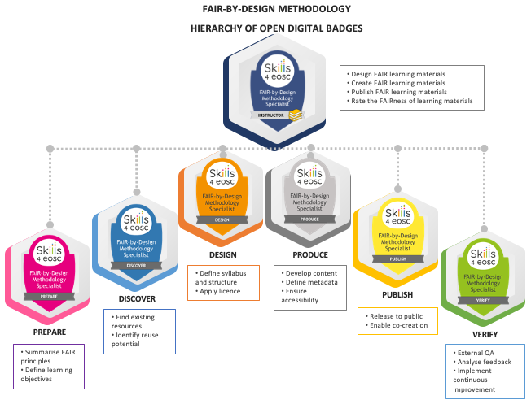
Using Hierarchical Badges
Define multiple badges within one training
Link each badge to a different set of micro-credentials
Higher-level badges are obtained once all lower-level badges are issued

Slide 15
Open Badges
PROs
CONs
Portability
Easily shared and verified across different platforms and institutions
Simplicity
Already implemented in a broad range of learning platforms
The threshold for starting to use them is fairly low
Transparency
The open standard and verifiable nature increases transparency and trust
Customisation
Can be highly customised to reflect specific learning outcomes or achievement levels
Value
Some employers may not yet recognize the value of digital badges, especially compared to traditional qualifications
Interoperability
Ensuring interoperability between different badge systems can be complex
Quality
There is a risk of badge inflation or the issuance of low quality-content badges
Recognition
Widespread adoption and formal recognition in the HE sector varies
More widespread among informal education providers

Slide 16
European Digital Credentials for learning
standardised
tamper evident
electronic documents
describing that their owner
has certain skills or has achieved certain learning outcomes
through formal, non-formal or informal learning context

Slide 17
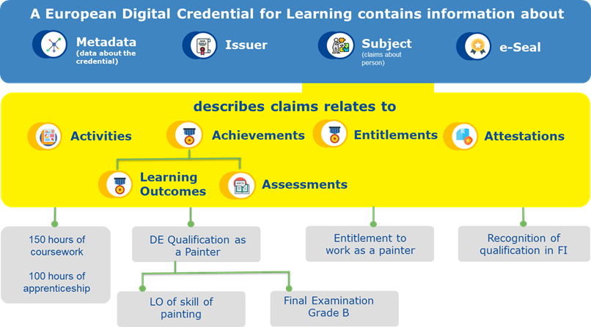
EDC content
Image taken from https://europa.eu/europass/en/stakeholders/european-digital-credentials

Slide 18


Credential example
Can be stored in a wallet integrated with europass

Slide 19
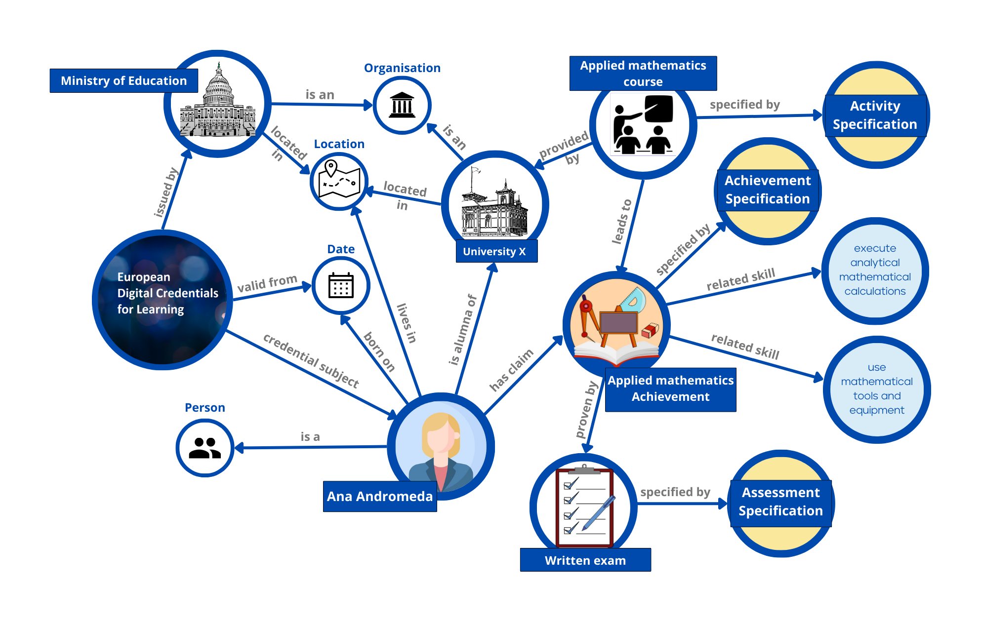
The European Learning Model (ELM)
Image by Europass taken from https://europa.eu/europass/en/node/2128

Slide 20
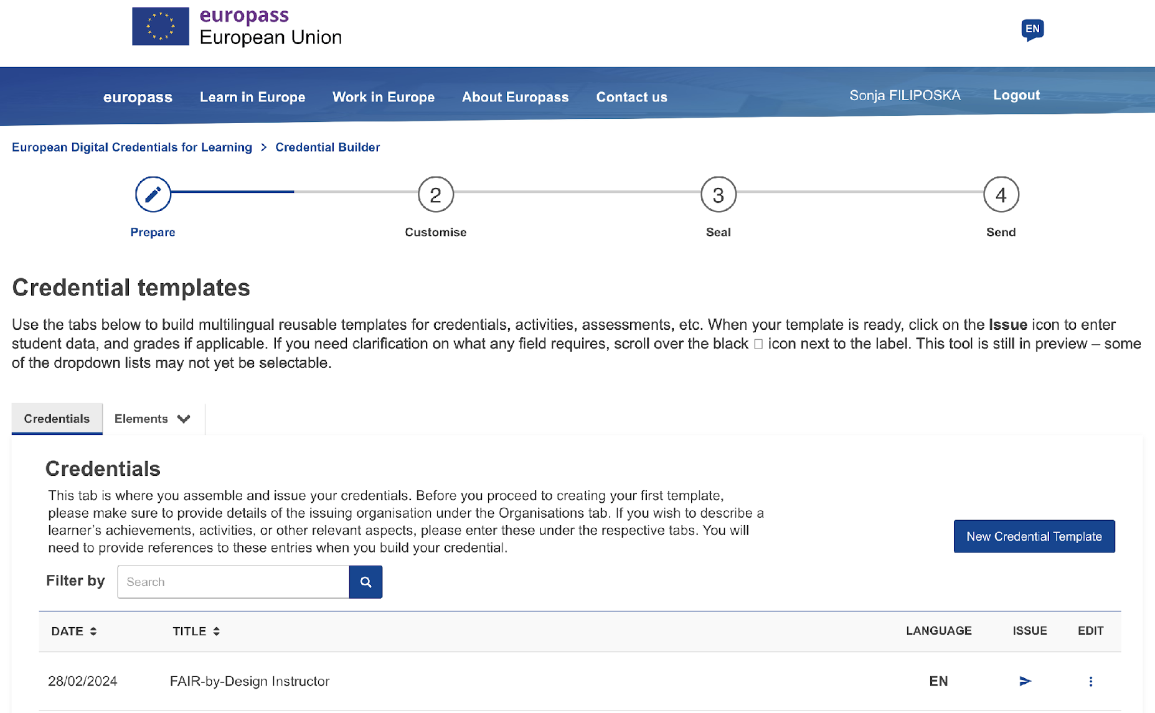
To issue an EDCs
The issuing institution needs to obtain a Qualified eSeal
Understand the ELM
Define (and customise) a template
Use the credential builder online
Prepare a list of receivers

Slide 21
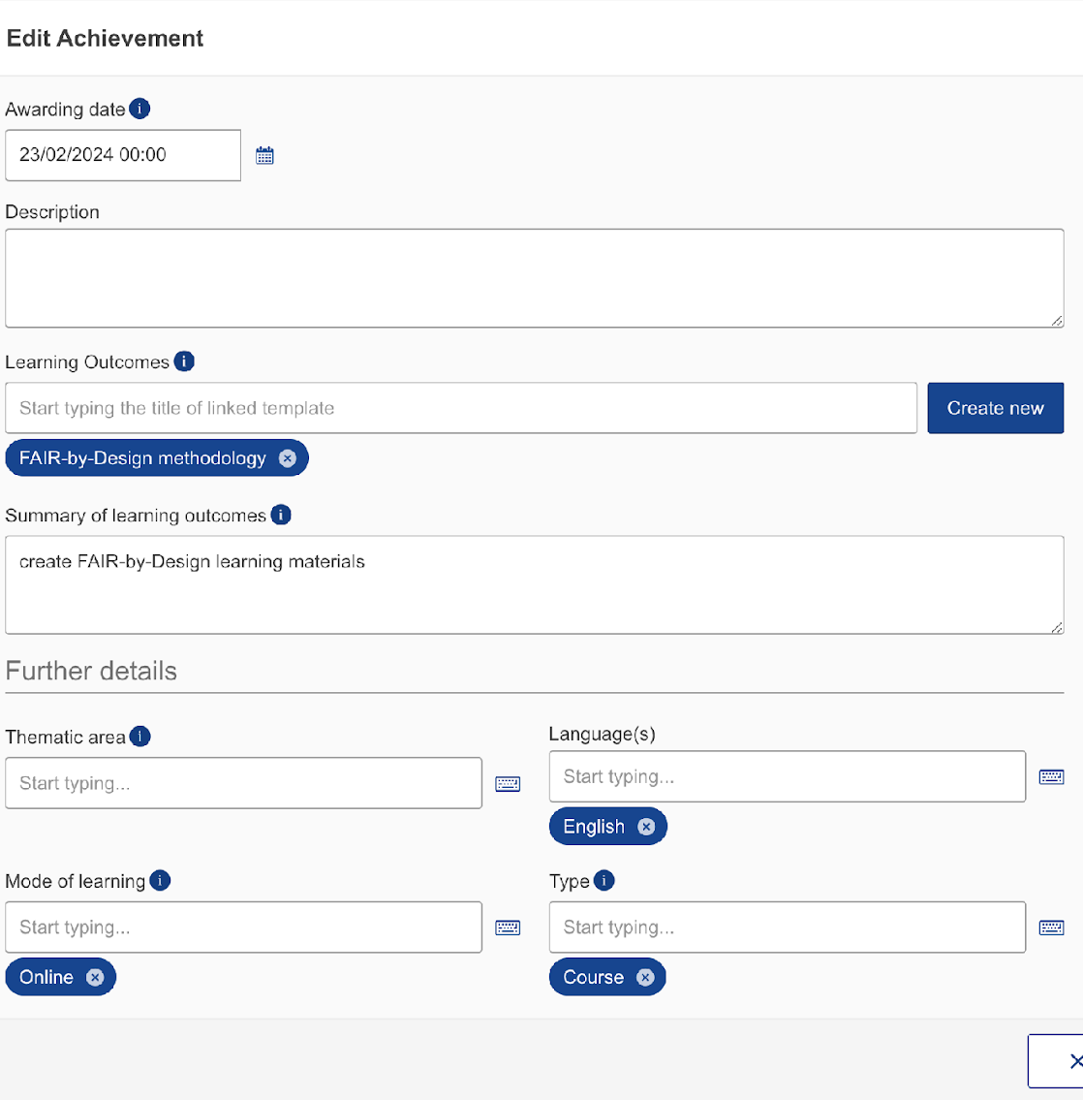
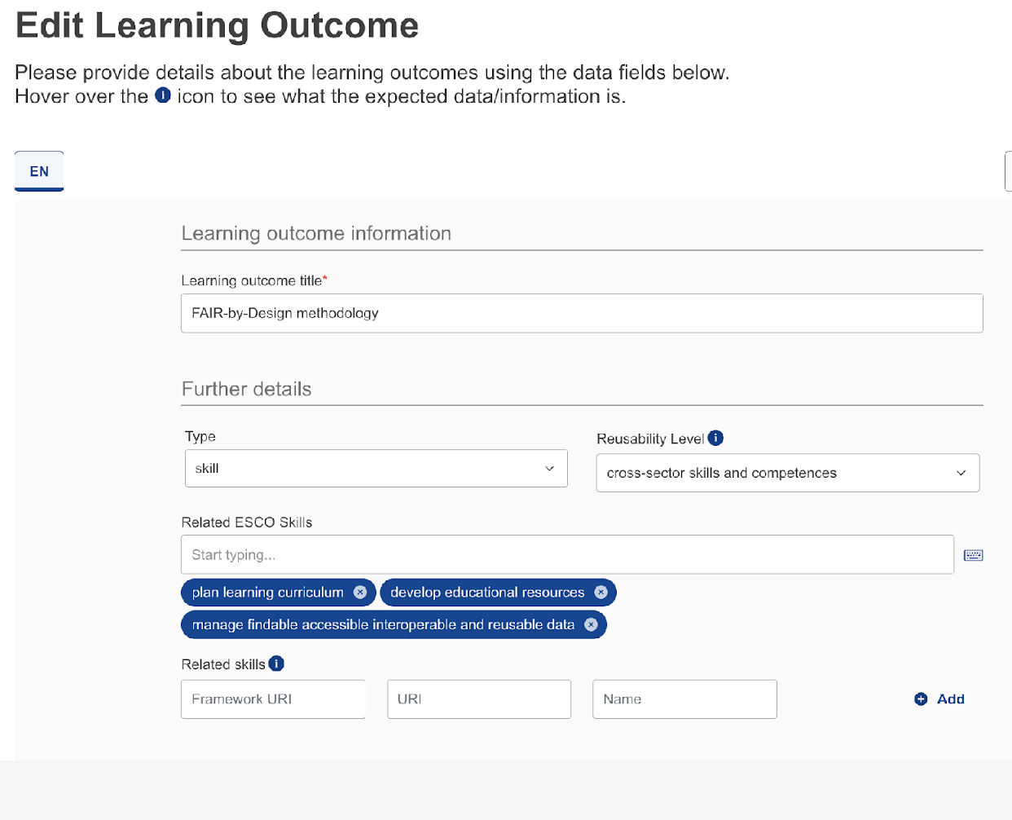
Defining a template (multilingual support)
Support for ontologies-based description of skills

Slide 22
EDCs
PROs
CONs
Political support and standardisation
Provides a consistent framework for recognizing qualifications across Europe. The solution has strong support from the European Commission.
Trustworthy
Issued by accredited institutions and signed with an electronic seal, ensuring they are verifiable.
Interoperability
Recognized across all EU member states, facilitating mobility and cross-border employment.
Compatibility
Can be easily aligned with national and EU-level qualifications frameworks and the ESCO skills vocabulary.
Integration and automation
Credentials issuing is currently a fairly manual process. Integrating EDC with existing learning systems and processes needs to be implemented by the issuer. Integration with popular learning platforms is currently still under development.
Bureaucracy
The process of acquiring the necessary eSeal and issuing and verifying EDCs can be complex and time-consuming.
Flexibility
Less flexible compared to open digital badges, particularly for informal learning achievements.
Limited adoption
Not yet widely adopted compared to Open Badges

Slide 23
The approaches are
Complementary
Can be used in conjunction

Slide 24
Open Badges or EDCs
Requirement | Open Badges | EDCs
Flexibility | Mostly used to represent informal and non-formal learning experiences. | Can be used to represent formal education in addition to informal and non-formal.
 | Current implementations provide a high-level description of the achievements in a less structured way. | Include rich and flexible metadata that can be used to capture the details of the learning experience.
 | Interoperable with various systems and platforms, widely accepted and recognized. | Compatible with other digital credential systems and aligned with European regulations.
Inexpensive | The standard is free and open, anyone can adopt and use it without any cost. There might be costs associated with the use of commercial platforms or services. | Organizations can issue EDCs without any licensing fees or subscription costs. There is a cost for acquiring the eSeal needed to issue the EDCs. It varies depending on the country and issuer. There are costs related to setting up and maintaining a local infrastructure and integration with learning platforms.

Slide 25
Open Badges or EDCs
Requirement | Open Badges | EDCs
Easy to implement | Based on an open standard, technical expertise and development is required if you want to implement from scratch. However, many readily available user-friendly tools and platforms already exist. | Good understanding of the underlying data model is required when developing credential templates. EC provides a user-friendly platform and detailed guidelines to facilitate the definition and issuing. Using a local installation that allows for more automation, requires much higher technical expertise.
Trustworthy | Earned badges can be stored in personal digital wallets or backpacks with personal control over the credentials and with whom they share them. Open Badges can be issued as digitally signed documents that can be independently verified. When following the newest standard, the structured data within Open Badges enables automated verification and recognition by systems. | Individuals can store their EDCs in Europass, then choose to share them with authorized parties. When an institution issues an EDC, it applies an eSeal to the digital document. A recipient can verify the eSeal to confirm that the credential has not been altered or compromised. The qualified eSeal is the highest level of electronic seal that equals to handwritten document.

Slide 26
Guidelines for Use
Advice from four different perspectives:
learners’ perspective,
course managers’ perspective,
platform administrators’ perspective, and

Slide 27
Hands-on activity
Apply your understanding of the Skills4EOSC framework and digital credentials (Open Badges and EDCs) to a practical scenario
Discuss the advantages and disadvantages of different credential types in the specific scenario context
Consider how the Skills4EOSC framework can help you with credential design and evaluation

Slide 28
Part 1: Choose a scenario
Scenario A: Upskilling Course Development A training center wants to develop a new self-paced online course on "Data Visualization for Research." They plan to offer digital credentials upon successful completion.
Scenario B: Trainer Recruitment A research institute is looking to hire a trainer to deliver a workshop on "Research Data Management." Applicants are asked to provide examples of their previous training experience, often including digital credentials.

Slide 29
Part 2: Small group work
Discuss the scenario
Answer the guiding questions provided on the worksheet
Focus on different perspectives

Slide 30
Part 3: Group Sharing & Discussion
Share your key findings and recommendations
reasoning behind the choices related to digital credential types
how the Skills4EOSC framework influenced your thinking
Common themes and contrasting approaches?
What are the key considerations for choosing one type of digital credential over another?
How can the Skills4EOSC framework help both training providers and those seeking training?

Slide 31
Thank you! Questions?

